Slide 1
Simulink Introduction

Slide 2
Simulink Introduction
Simulink is a graphical programming language
Instead of writing a lot of code, Simulink involves connecting blocks that are preprogrammed for certain functions
It is mainly used for time varying systems

Slide 3
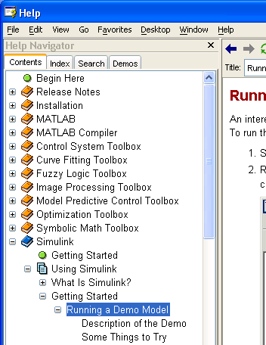
Getting Started
Go to the Contents Tab on the help menu
Under Simulink \ Using Simulink \ Getting Started… select “Running a Demo Model” (see the diagram to the right)
Follow the instructions

Slide 4
Getting Started
Continue on with the “Some Things to Try” section
Spend some time playing with this system
See if you can change the boundaries of when the thermostat activates the furnace (it defaults to +/- 5 degs) Try changing it to +/-1 deg.
Zoom in on parts of the plot (auto scale the plot by clicking on the binocular icon)

